Slide 1


STUDY OF FEYNMAN DIAGRAMS WITH QUANTUM GRAPH NEURAL NETWORK
UNIVERSITÀ DEGLI STUDI DI MILANO-BICOCCA
Scuola di Scienze
Dipartimento di Fisica «Giuseppe Occhialini»
Corso di Laurea Magistrale in Fisica
Tesi di Laurea Magistrale
Lorenzo Ballerio
Matr. 838676
Relatore Interno: Prof. Andrea Giachero
Relatore Esterno: Dott. Michele Grossi
Correlatore: Dott. Roberto Moretti
Correlatore: Prof. Pietro Govoni
Correlatore: Dott. Danilo Labranca
Anno Accademico 2022/2023 – Sessione di Novembre

Slide 2
Summary
Idea of Project
Scattering Amplitudes in Quantum Field Theory (QFT)
Quantum Computing and Quantum Graph Neural Networks
QGNN for Feynman diagrams
Performance of the Quantum Graph Neural Network
Conclusions and Future Directions

Slide 3
Idea of the Project

Slide 4
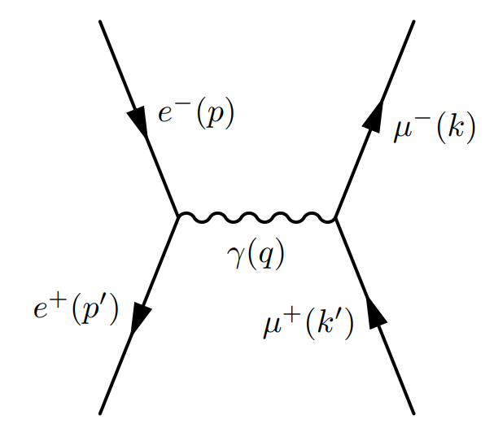
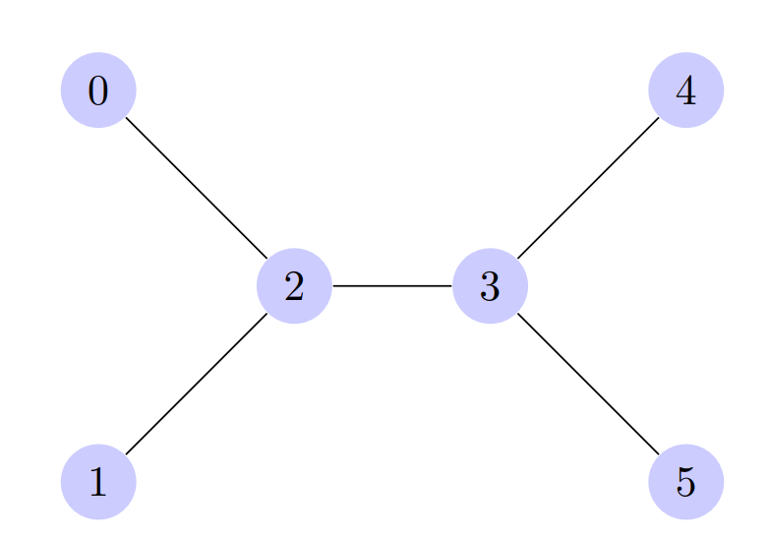
Idea of the Model
Our goal:
Build a quantum supervised regression model that can compute the scattering amplitude squared for a Feynman diagram.
Strategy:
Encode the diagram as a labeled graph
Topology encoded in the adjacency matrix of the graph
Particles (m,Q,S) encoded in the edges
Time flow (initial state, interaction vertex, final state) encoded in the vertices
20/11/2023
Study of Feynman diagrams with quantum graph neural network – Lorenzo Ballerio

Slide 5
Scattering Amplitudes in Quantum Field Theory (QFT)

Slide 6
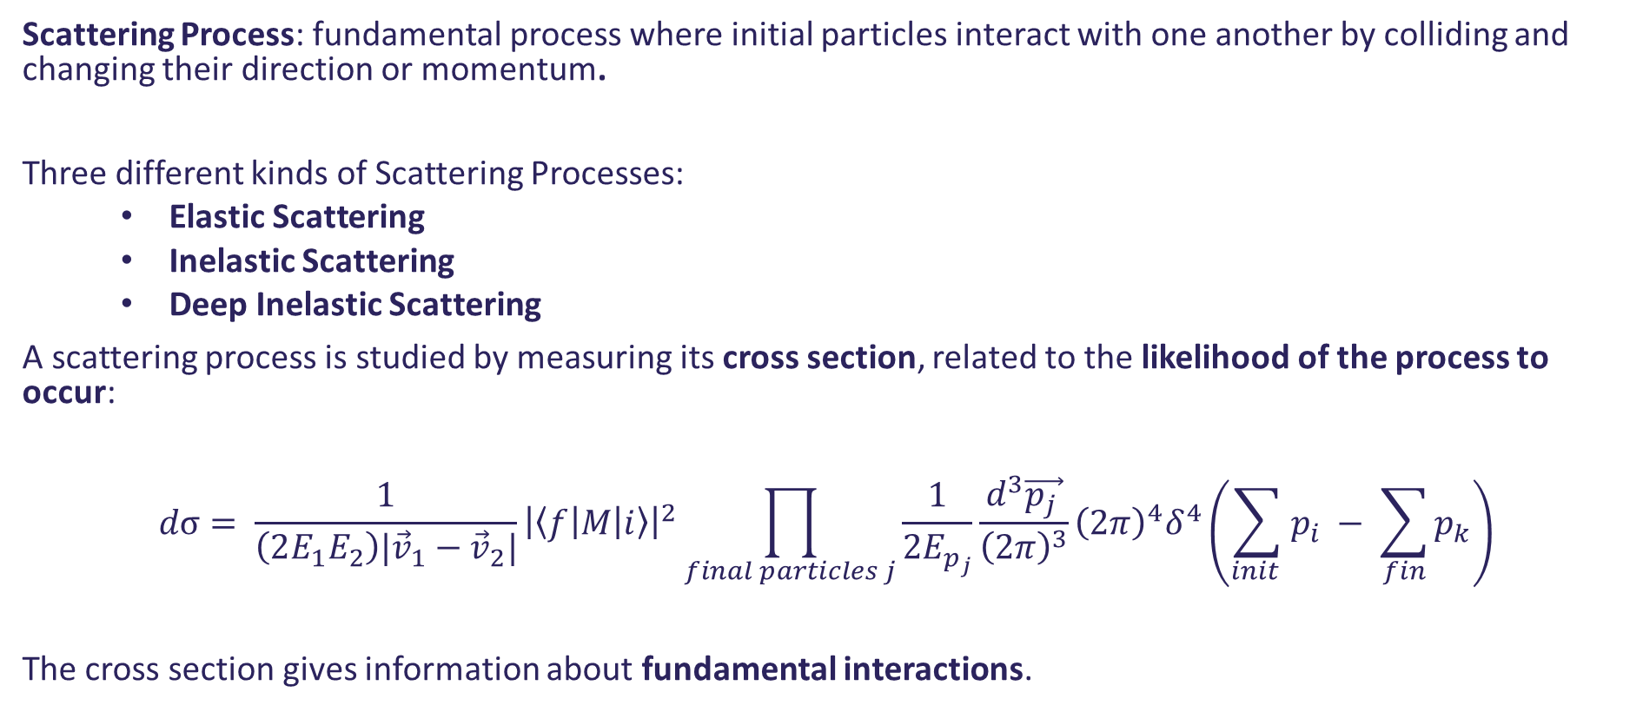
Scattering Theory I
Scattering Process: fundamental process where initial particles interact with one another by colliding and changing their direction or momentum.
Three different kinds of Scattering Processes:
Elastic Scattering
Inelastic Scattering
Deep Inelastic Scattering
A scattering process is studied by measuring its cross section, related to the likelihood of the process to occur:
$$dσ= \frac{1}{\left(2E_{1}E_{2}\right)|{\vec{v}}_{1}−{\vec{v}}_{2}|}{\left|\left\langle f | M | i\right\rangle \right|}^{2}\prod_{final particles j}{\frac{1}{2E_{p_{j}}}\frac{d^{3}\vec{p_{j }}}{{\left(2π\right)}^{3}}{\left(2π\right)}^{4}δ^{4}\left(\sum_{init }{p_{i} − \sum_{fin}{p_{k}}}\right)}$$
The cross section gives information about fundamental interactions.

Slide 7
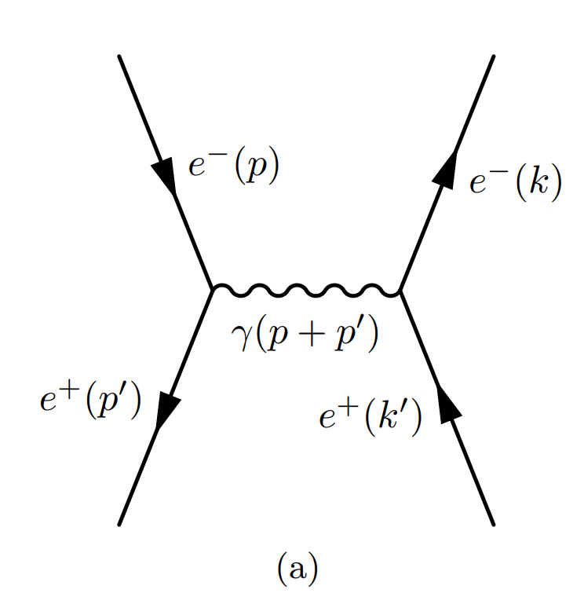
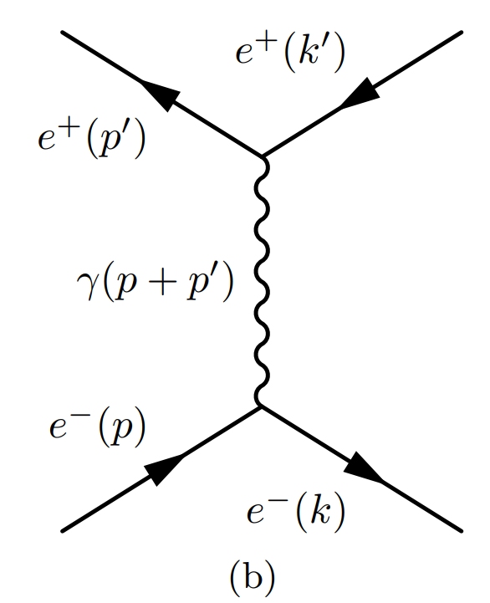
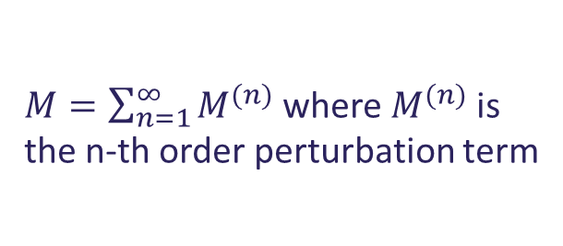
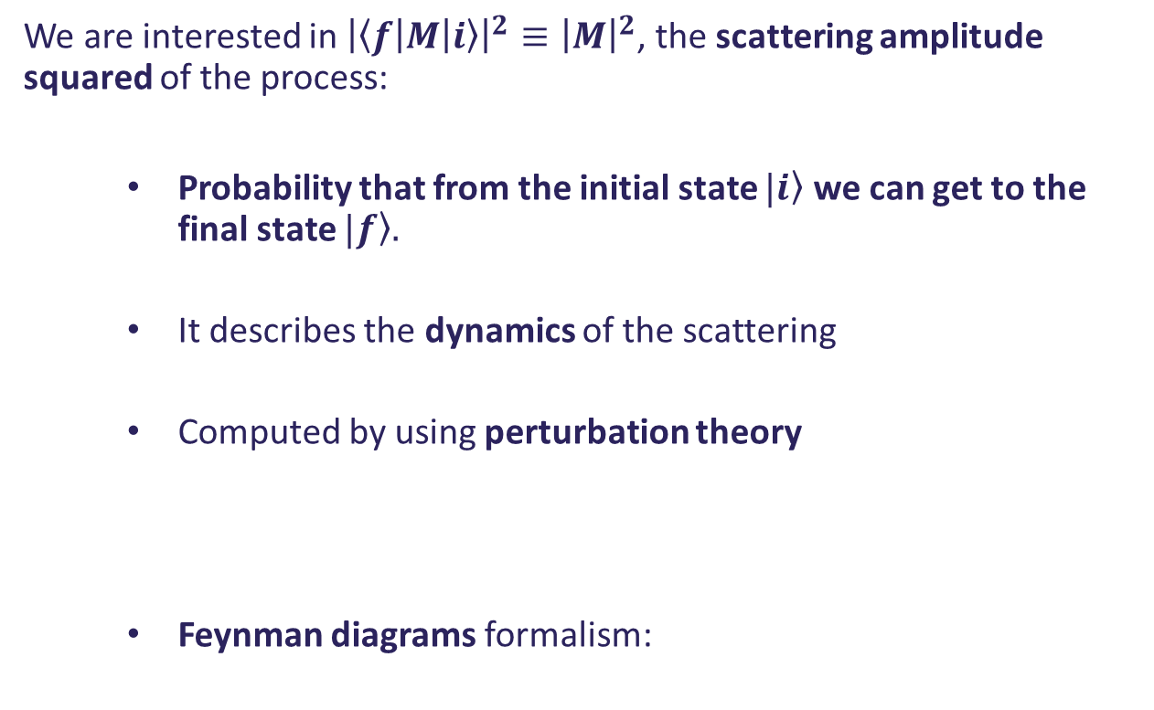
Scattering Theory II
We are interested in ${\left|\left\langle f | M | i\right\rangle \right|}^{2}≡{\left|M\right|}^{2}$, the scattering amplitude squared of the process:
Probability that from the initial state $\left.|i\right\rangle$ we can get to the final state $\left.|f\right\rangle .$
It describes the dynamics of the scattering
Computed by using perturbation theory
Feynman diagrams formalism:
$M=\sum_{n=1}^{∞}{M^{(n)}}$ where $M^{(n)}$ is the n-th order perturbation term
Associating a mathematical expression to each graph component: Feynman Rules

Slide 8
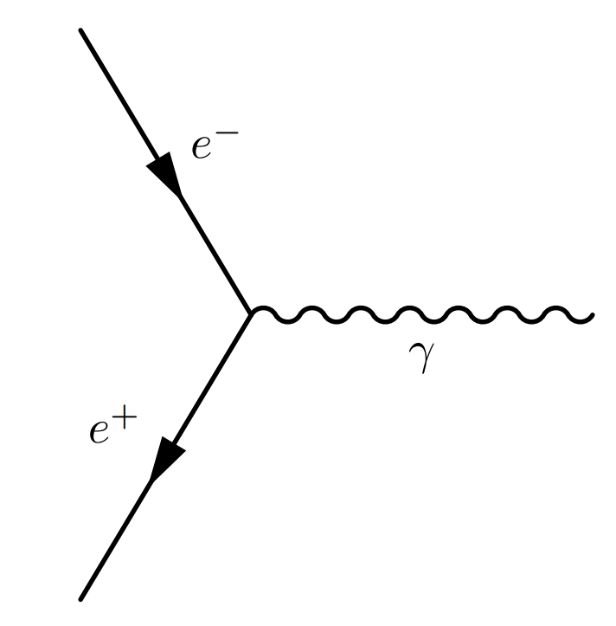
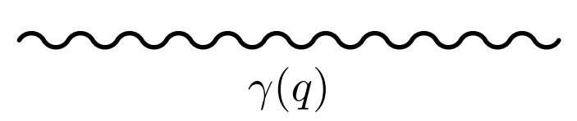
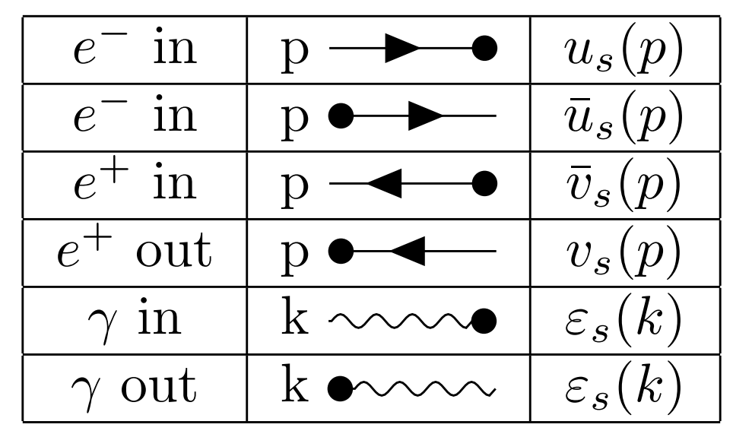
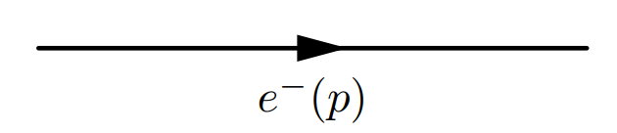
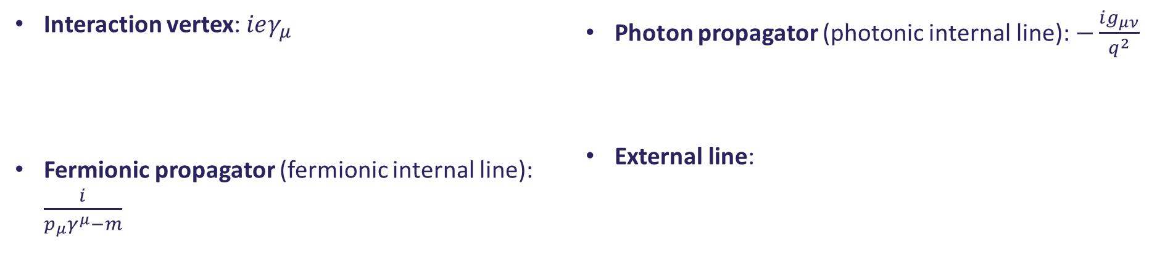
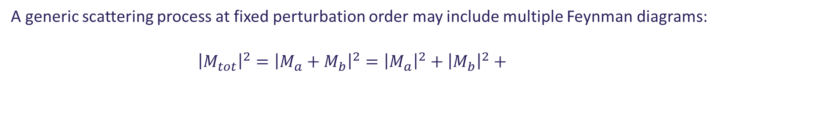
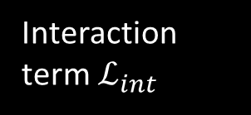
Scattering Theory III
A generic scattering process at fixed perturbation order may include multiple Feynman diagrams:
$${\left|M_{tot}\right|}^{2}={\left|M_{a}+M_{b}\right|}^{2}={\left|M_{a}\right|}^{2}+{\left|M_{b}\right|}^{2}+M_{a}M_{b}^{∗}+M_{a}^{∗}M_{b}$$
Appereance of an interference term, quantum effect
Interaction term $ℒ_{int}$
Quantum Electrodynamics (QED): $ℒ_{QED}=−\frac{1}{4}F^{μν}F_{μν}+\overline{ψ}\left(i∂_{μ}γ^{ μ}−m\right)ψ+e\overline{ψ}A_{μ}γ^{μ}ψ$
Feynman rules for QED in momentum space:
Interaction vertex: $ieγ_{μ}$
Fermionic propagator (fermionic internal line): $\frac{i}{p_{μ}γ^{μ}−m}$
Photon propagator (photonic internal line): $−\frac{ig_{μν}}{q^{2}}$
External line:

Slide 9
Quantum Computing and Quantum Graph Neural Networks

Slide 10
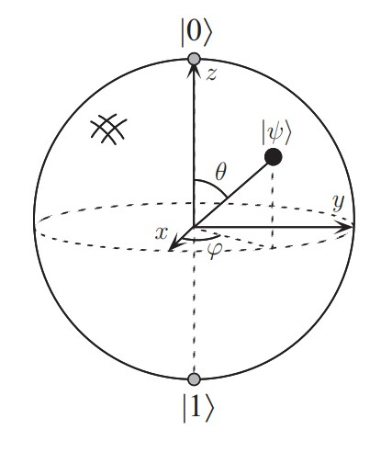
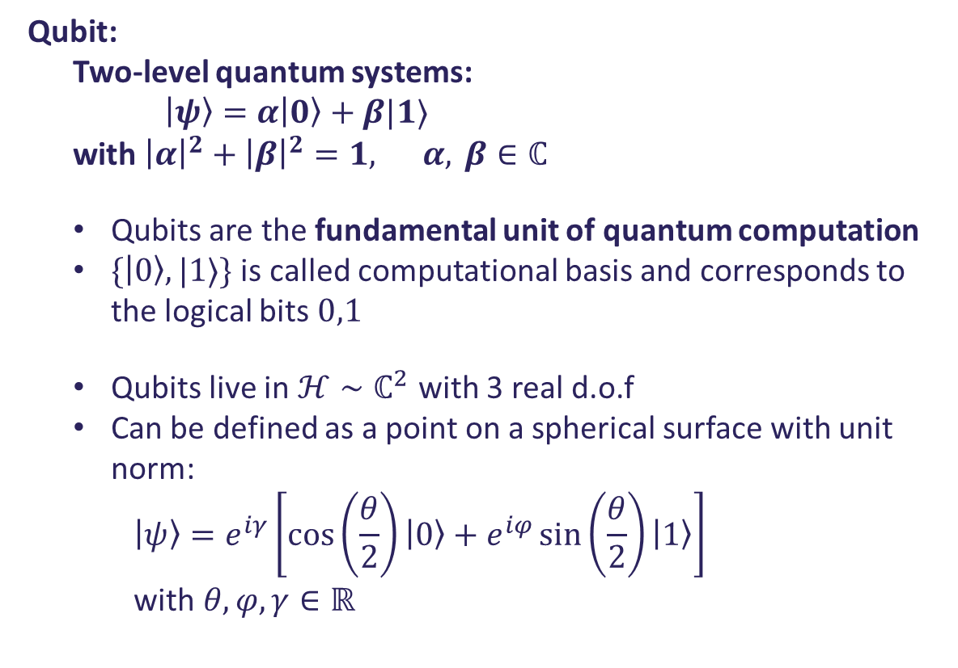
Qubits
Qubit:
Two-level quantum systems:
$\left|ψ\right\rangle =α\left|0\right\rangle +β|1⟩$
with ${\left|α\right|}^{2}+{\left|β\right|}^{2}=1, α, β∈ℂ$
Qubits are the fundamental unit of quantum computation
$\{\left|0\right\rangle ,|1⟩\}$ is called computational basis and corresponds to the logical bits $0,1$
Qubits live in $ℋ∼ℂ^{2}$ with 3 real d.o.f
Can be defined as a point on a spherical surface with unit norm:
$$\left|ψ\right\rangle =e^{iγ}\left[\cos\left(\frac{θ}{2}\right)\left|0\right\rangle +e^{iφ}\sin\left(\frac{θ}{2}\right)\left|1\right\rangle \right]$$
with $θ,φ,γ∈ℝ$
Quantum Computing (QC) is the paradigm that exploits quantum mechanical properties of matter in order to do calculations.
Bloch Sphere

Slide 11
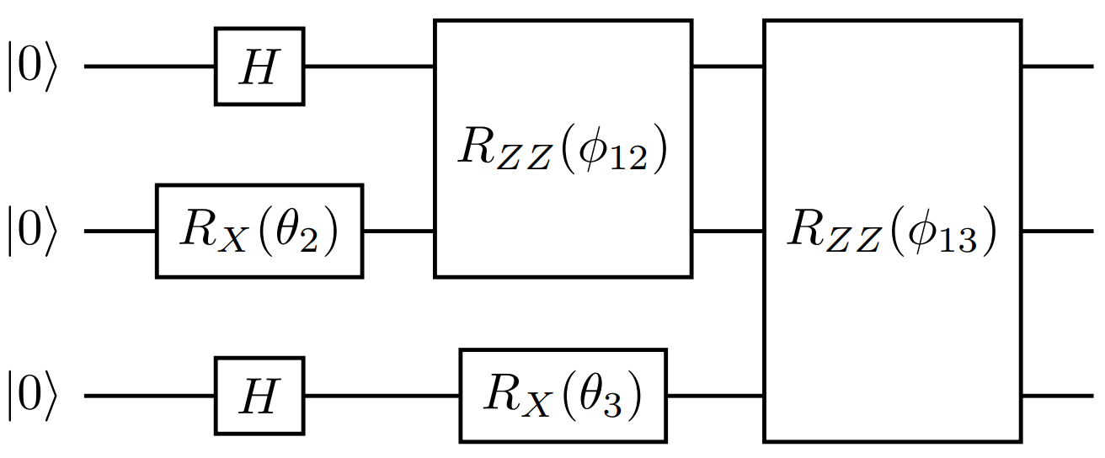

Quantum Circuits
Examples of quantum gates:
$H= \frac{1}{\sqrt{2}}\left[\begin{matrix}1 & 1 \\ 1 & −1\end{matrix}\right]$ Hadamard gate:
$$H\left|0\right\rangle =\frac{1}{\sqrt{2}}(|0⟩+|1⟩)=|+⟩$$
$H|1⟩=\frac{1}{\sqrt{2}} (\left|0\right\rangle −|1⟩)=|−⟩$
Single qubit Pauli rotation along $\vec{n}$:
$$R_{\vec{n}}\left(θ\right)=e^{\frac{iθ}{2}\vec{σ}⋅\vec{n}}$$
$R_{2}\left(γ,ρ\right)=\frac{1}{\sqrt{2}} \left[\begin{matrix}1 & e^{−iρ} \\ e^{iγ} & e^{i(ρ+γ)}\end{matrix}\right]$
$R_{1}\left(τ\right)=e^{iτ}R_{Z}\left(τ\right)= \left[\begin{matrix}1 & 0 \\ 0 & e^{iτ}\end{matrix}\right]$
$R_{ZZ}\left(φ\right)=\exp\left(−i\frac{φ}{2}Z⊗Z\right)$ Ising ZZ coupling gate
Information processed via unitary operators called quantum gates, collected in quantum circuits.
Quantum Computing is by definition reversible and universal.
can be defined a finite set of gates that can approximate any unitary operation (any function).
2-qubits operators, creates entanglement between qubits.

Slide 12
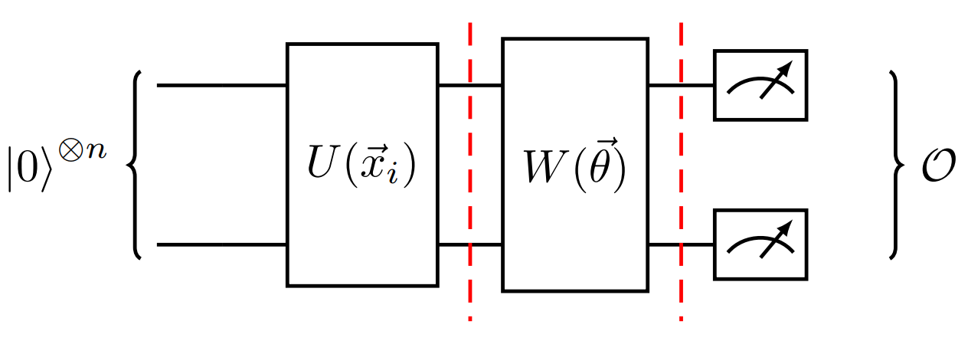
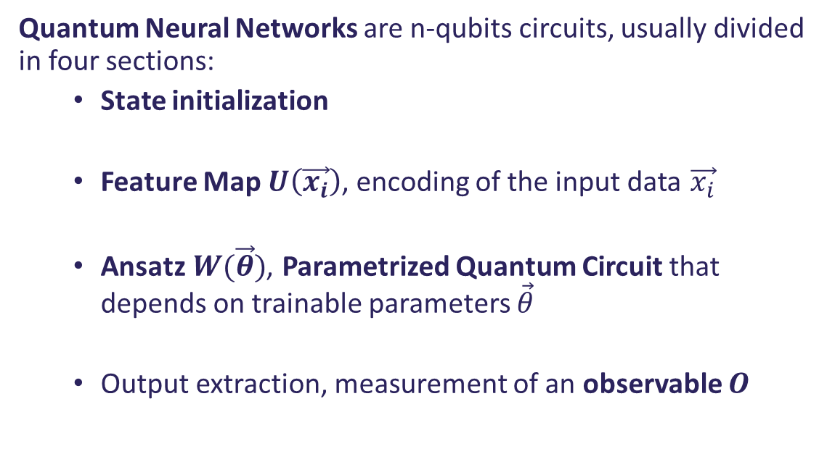
Quantum Neural Network (QNN)
Quantum Machine Learning (QML) combines Machine Learning and Quantum Computing with the aim of exploiting the principles of quantum mechanics to develop new learning models.
Quantum Neural Networks are n-qubits circuits, usually divided in four sections:
State initialization
Feature Map $U\left(\vec{x_{i}}\right)$, encoding of the input data $\vec{x_{i}}$
Ansatz $W(\vec{θ})$, Parametrized Quantum Circuit that depends on trainable parameters $\vec{θ}$
Output extraction, measurement of an observable $O$
Scheme for a generic QNN

Slide 13
QGNN for Feynman diagrams

Slide 14
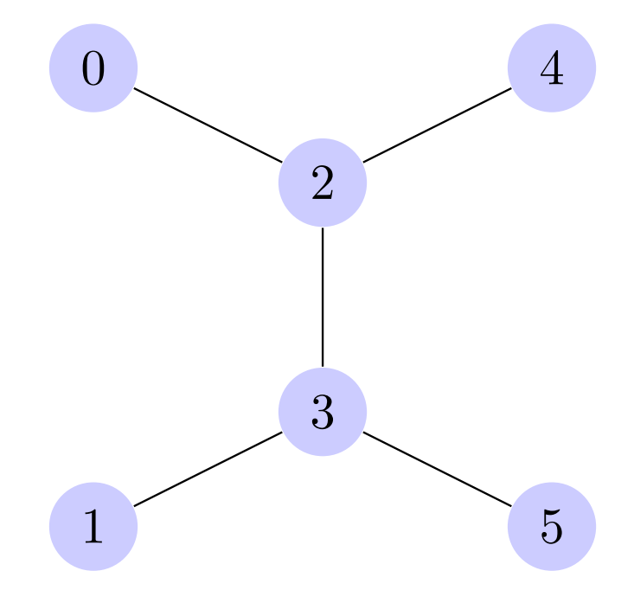
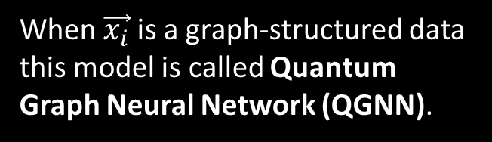


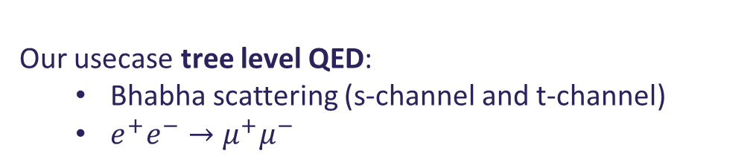
Datasets
G labeled graph $G=(V,E,X_{V}, X_{E})$
V set of vertices
E set of edges
$X_{V}$ vertex feature set (1-hot encoding)
$X_{E}$ edge features set $(m,Q,S)$
$θ$ scattering angle
p momentum of the initial particles
$\hat{y}$ theoretical value of ${\overline{\left|M\right|}}^{2}$ computed analitycally
Data structure: $\left[ \left(G,θ,p\right), \hat{y}\right]$
Our usecase tree level QED:
Bhabha scattering (s-channel and t-channel)
$e^{+}e^{−}→μ^{+}μ^{−}$
Any graph has the same number of vertices $\left|V\left(G\right)\right|=6$, the QGNN has a constant number of qubits.
Very similar edge sets $E_{s}$ and $E_{t}$
When $\vec{x_{i}}$ is a graph-structured data this model is called Quantum Graph Neural Network (QGNN).
t-channel
s-channel
20/11/2023
Study of Feynman diagrams with quantum graph neural network – Lorenzo Ballerio

Slide 15
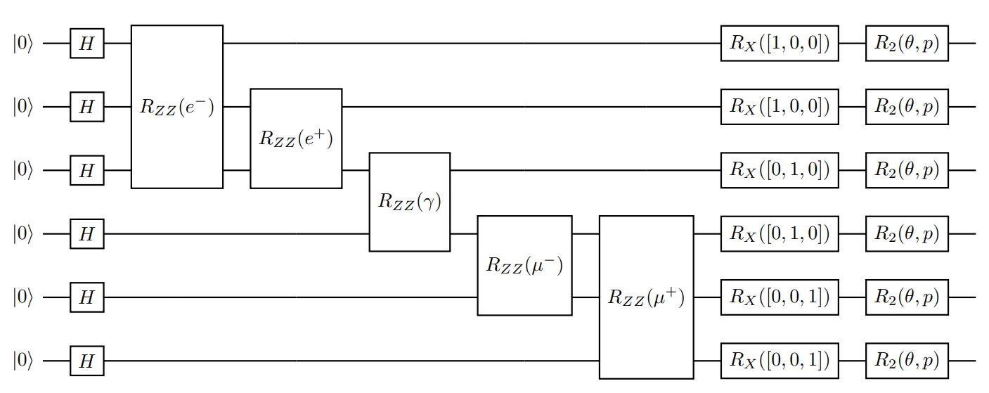
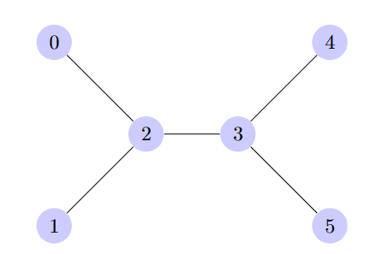
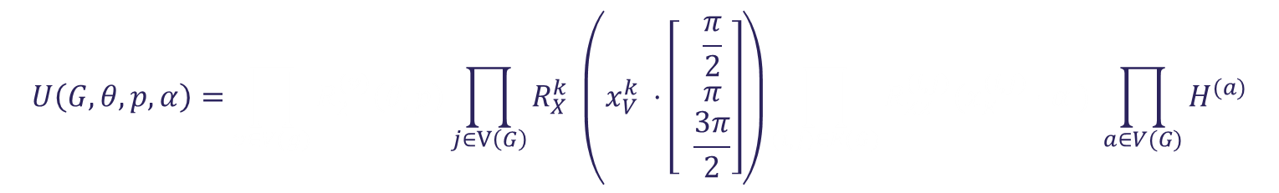
Feature Map
Best model to hande this kind of data is a QGNN.
Model Architecture:
Data encoding Feature Map
$$U\left(G,θ,p,α\right)=\prod_{v∈V(g)}{R_{2}^{\left(v\right)}\left(θ,p\right)}\prod_{j∈V\left(G\right)}{R_{X}^{k} \left(x_{V}^{k} ⋅\left[ \begin{matrix}\frac{π}{2} \\ π \\ \frac{3π}{2}\end{matrix}\right]\right)}\prod_{(i,j)∈E(G)}{R_{ZZ}^{\left(i,j\right)}(x_{E}^{\left(i,j\right)}⋅α )} \prod_{a∈V(G)}{H^{(a)}}$$
The qubits correspond to the vertices of the graph.
Connectivity of the circuit equal to the topology of the graph.
20/11/2023
Study of Feynman diagrams with quantum graph neural network – Lorenzo Ballerio

Slide 16
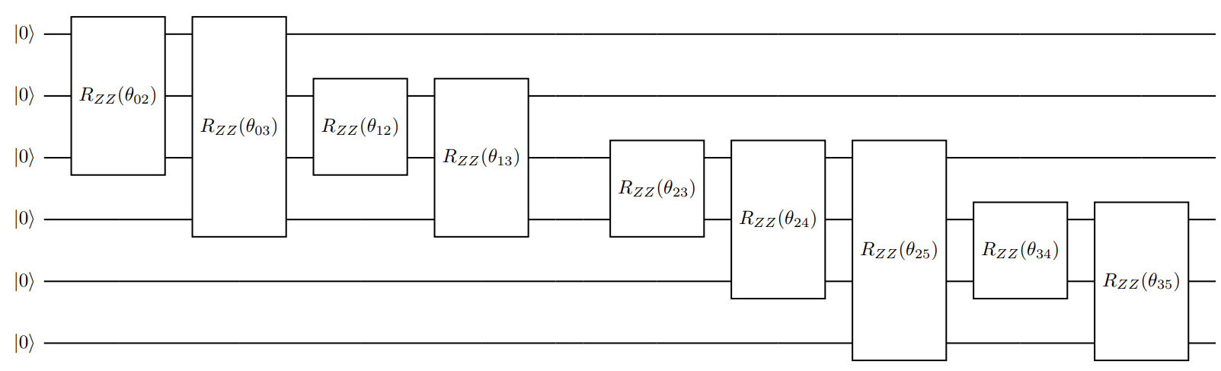
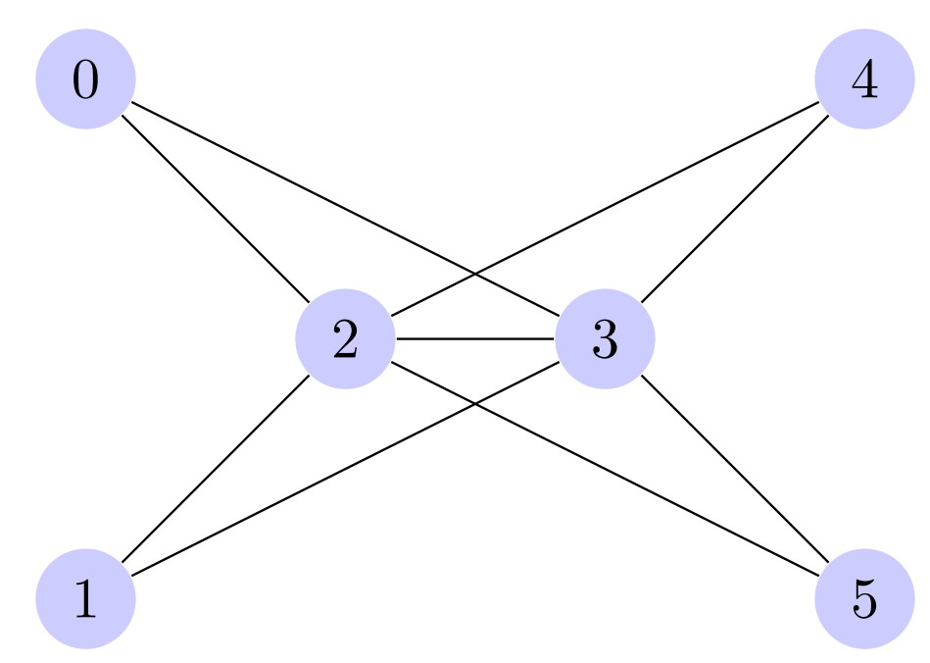
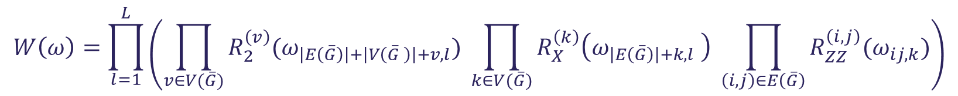
Ansatz of the Model
It includes different graph topologies
Trainable part of the circuit Ansatz
Similar architecture of the Feature Map, but it has more connectivity among qubits.
$$W\left(ω\right)=\prod_{l=1}^{L}{\left(\prod_{v∈V(\overline{G})}{R_{2}^{\left(v\right)}(ω_{\left|E\left(\overline{G}\right)\right|+\left|V\left(\overline{G} \right)\right|+v,l})} \prod_{k∈V(\overline{G})}{R_{X}^{\left(k\right)}\left(ω_{\left|E\left(\overline{G}\right)\right|+k,l} \right) \prod_{\left(i,j\right)∈E\left(\overline{G}\right)}{R_{ZZ}^{\left(i,j\right)}(ω_{ij,k})}}\right)}$$
Graph that includes all the possible QED processes at tree level
20/11/2023
Study of Feynman diagrams with quantum graph neural network – Lorenzo Ballerio

Slide 17
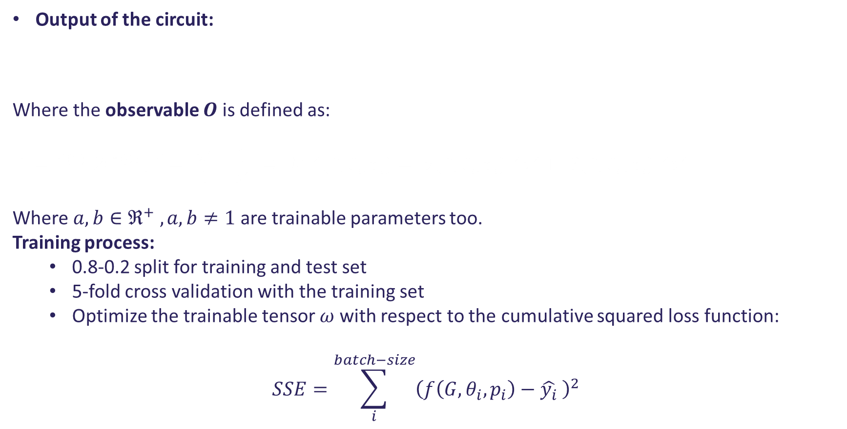
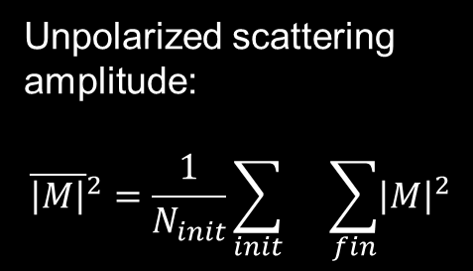
Output of the QGNN
Output of the circuit:
Where the observable $O$ is defined as:
$$O={\tilde{O}}^{(1)}⊗𝕀^{⊗5 }, \tilde{O}=\left[\begin{matrix}a^{2} & 0 \\ 0 & b^{2}\end{matrix}\right]⇒{\overline{\left|M\right|}}^{2}(G,θ_{i},p_{i})={\left|α({G,θ}_{i},p_{i})\right|}^{2}a^{2}+{\left|β(G{,θ}_{i},p_{i})\right|}^{2}b^{2}$$
Where $a,b∈ℜ^{+} , a,b≠1$ are trainable parameters too.
Training process:
0.8-0.2 split for training and test set
5-fold cross validation with the training set
Optimize the trainable tensor $ω$ with respect to the cumulative squared loss function:
$$SSE=\sum_{i}^{batch−size}{{\left(f\left({G,θ}_{i},p_{i}\right)−\hat{y_{i}} \right)}^{2}}$$
$$f\left(G,θ_{i},p_{i}\right)≡\left\langle O\right\rangle = \left\langle ψ | O | ψ\right\rangle = \left\langle 0 | U^{†}\left(G,θ_{i},p_{i},α\right)W^{†}\left(ω\right)O\left(a,b\right)W\left(ω\right)U\left(G,θ_{i},p_{i},α\right) | 0\right\rangle ≡{\overline{\left|M\right|}}^{2}(G,θ_{i},p_{i})$$
Unpolarized scattering amplitude:
$${\overline{\left|M\right|}}^{2}=\frac{1}{N_{init}}\sum_{init}{}\sum_{fin}{{\left|M\right|}^{2}}$$
20/11/2023
Study of Feynman diagrams with quantum graph neural network – Lorenzo Ballerio

Slide 18
Performance of the Quantum Graph Neural Network

Slide 19
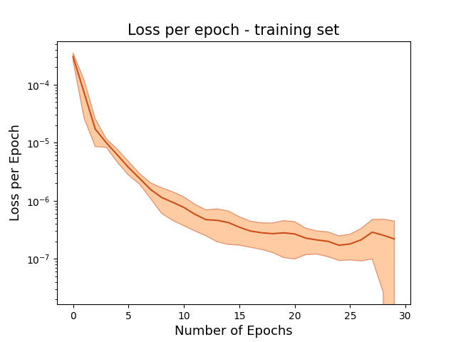
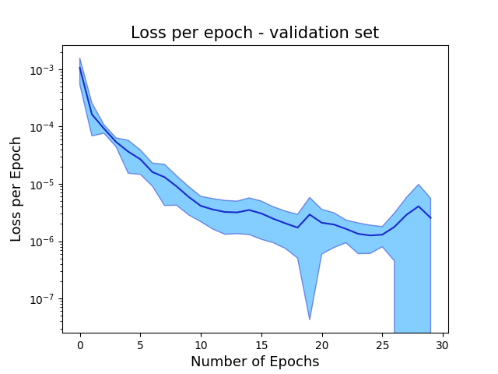
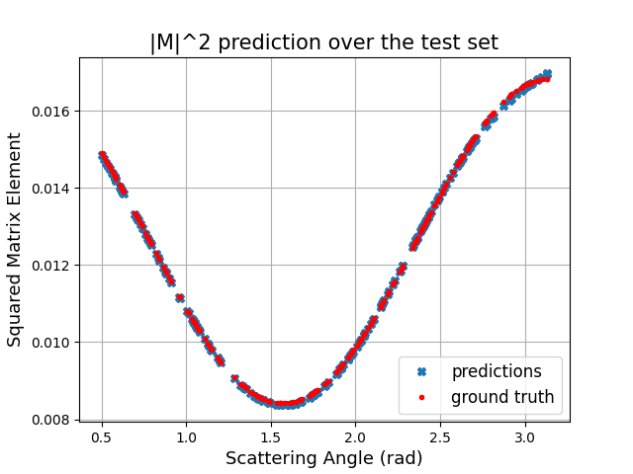

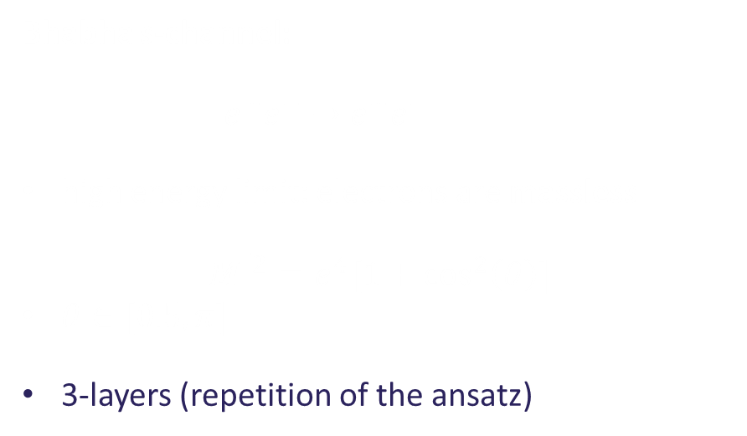
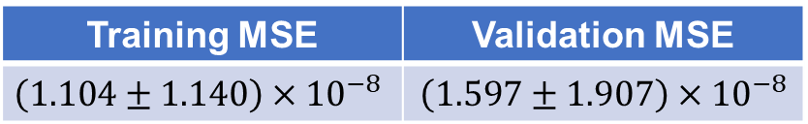
Performance for Bhabha s-channel I
Bhabha s-channel:
$e^{+}e^{−}→e^{+}e^{−}$
high energy limit: electrons are massless
$${\overline{\left|M\right|}}^{2}=e^{4}[1+\cos^{2}\left(θ\right)]$$
$θ∈[0.5, π]$
3-layers (repetition of the ansatz)
Training MSE | Validation MSE
$$\left(1.104±1.140\right)×{10}^{−8}$$ | $$\left(1.597±1.907\right)×{10}^{−8}$$
MSE after test evaluation: $1.838×{10}^{−9}$
20/11/2023
Study of Feynman diagrams with quantum graph neural network – Lorenzo Ballerio

Slide 20
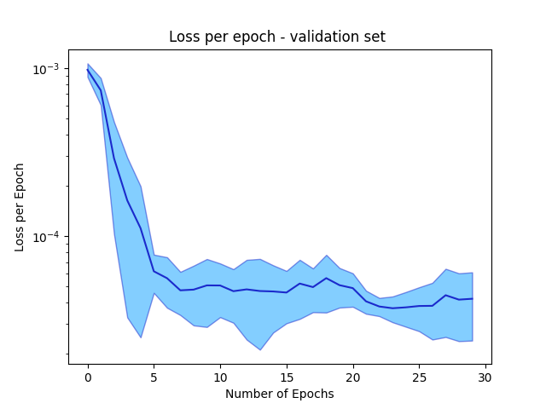
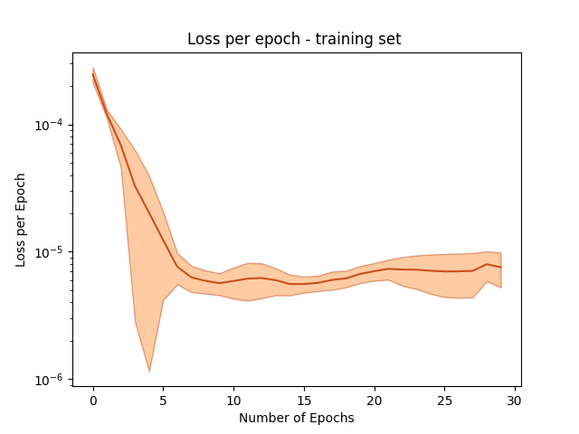
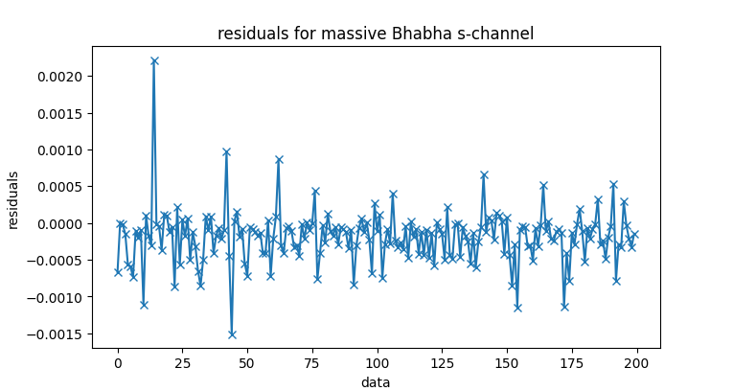
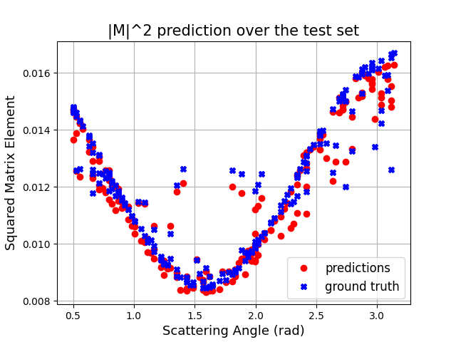
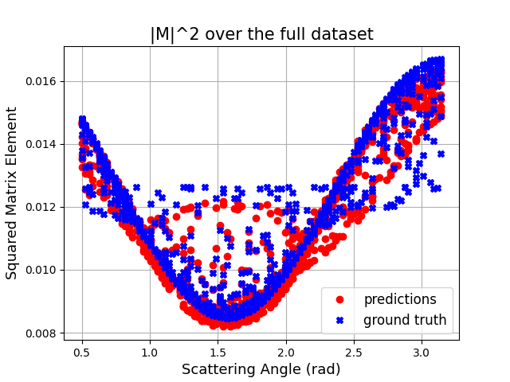
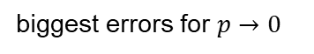

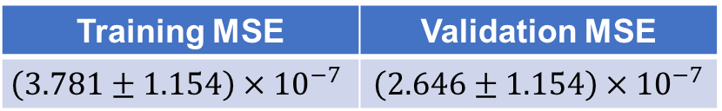

Performance for Bhabha s-channel II
Bhabha s-channel low-energy limit:
$${\overline{\left|M\right|}}^{2}=e^{4}\left[1+ \frac{p^{4}\cos^{2}\left(θ\right)}{{\left(p^{2}+m^{2}\right)}^{2}}+ \frac{m^{2}}{2\left(p^{2}+m^{2}\right)}\right]$$
$p∈[0.0,5.0]$MeV, $θ∈\left[0.5,π\right]$
Training MSE | Validation MSE
$$\left(3.781±1.154\right)×{10}^{−7}$$ | $$\left(2.646±1.154\right)×{10}^{−7}$$
MSE after test evaluation: $1.686×{10}^{−7}$
biggest errors for $p→0$
20/11/2023
Study of Feynman diagrams with quantum graph neural network – Lorenzo Ballerio

Slide 21
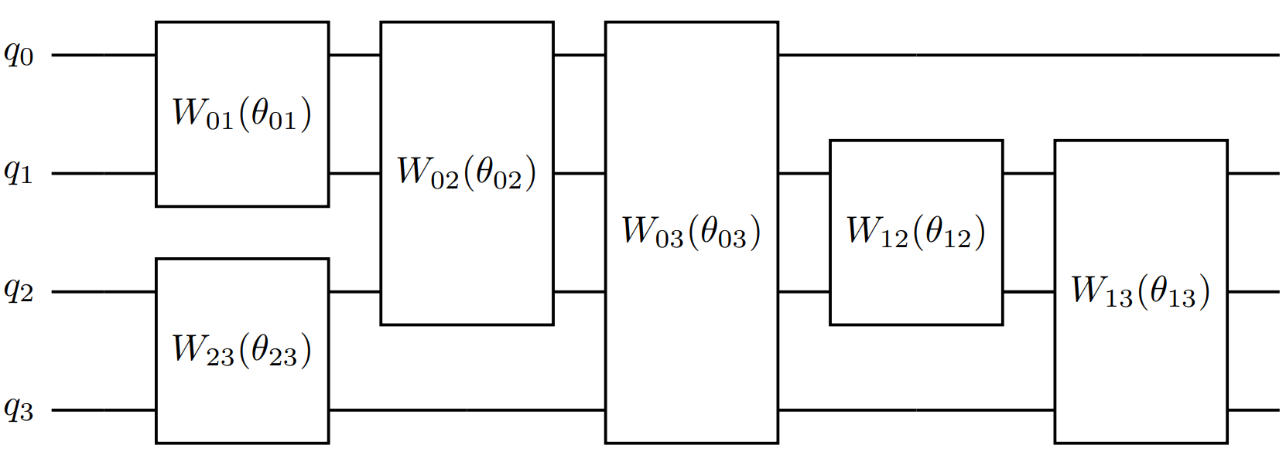
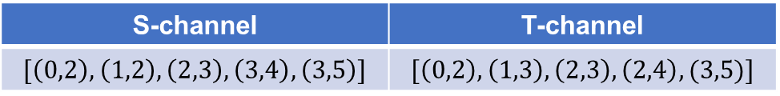
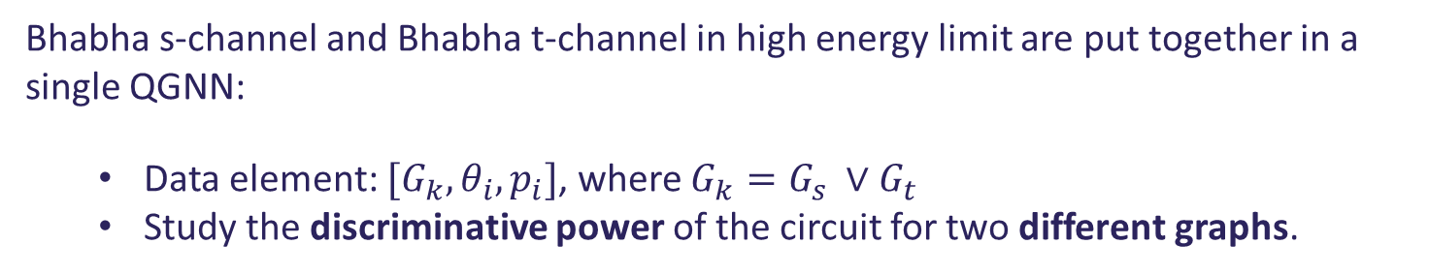
QGNN for multiple Feynman diagrams
Bhabha s-channel and Bhabha t-channel in high energy limit are put together in a single QGNN:
Data element: $[G_{k},θ_{i}, p_{i}]$, where $G_{k}=G_{s} ∨G_{t}$
Study the discriminative power of the circuit for two different graphs.
The two graphs are very similar, distiguish them is a complex task.
In order to augment the expressibility of the circuit the ansatz is changed:
Fully connected Ansatz (full connection between all qubits)
S-channel | T-channel
$$[\left(0,2\right),\left(1,2\right),\left(2,3\right),\left(3,4\right),\left(3,5\right)]$$ | $$[\left(0,2\right),\left(1,3\right),\left(2,3\right),\left(2,4\right),(3,5)]$$
Edge lists of the two channels
all-to-all Graph Transformer attention and message passing mechanisms.
20/11/2023
Study of Feynman diagrams with quantum graph neural network – Lorenzo Ballerio

Slide 22
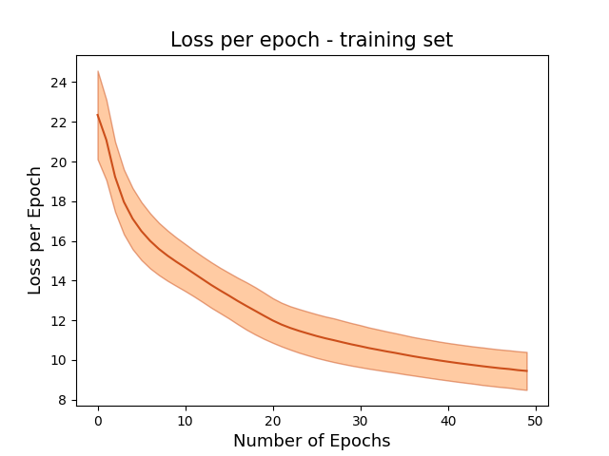
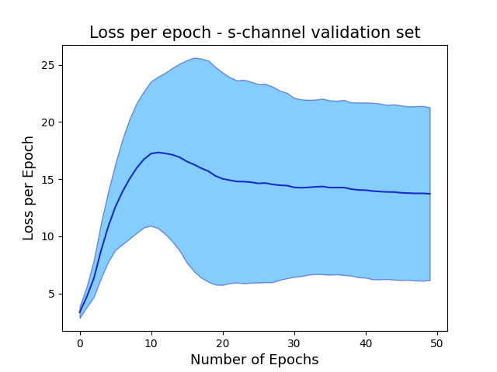
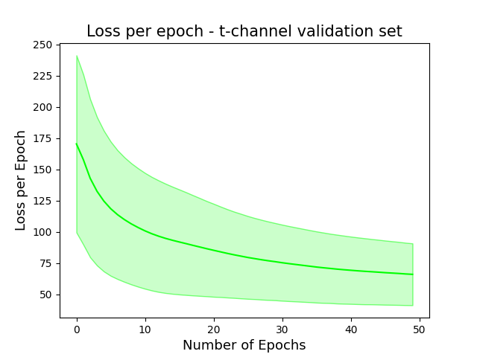
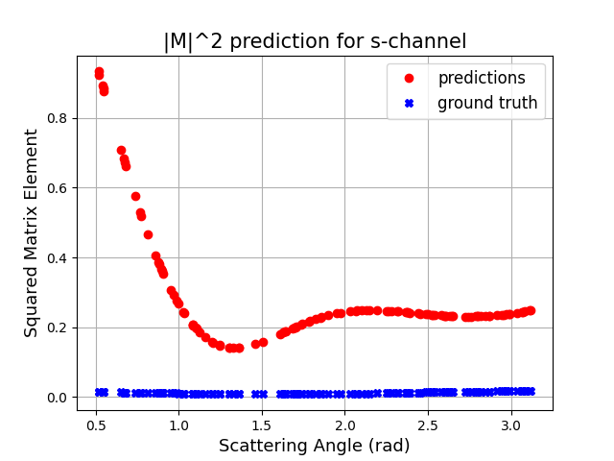
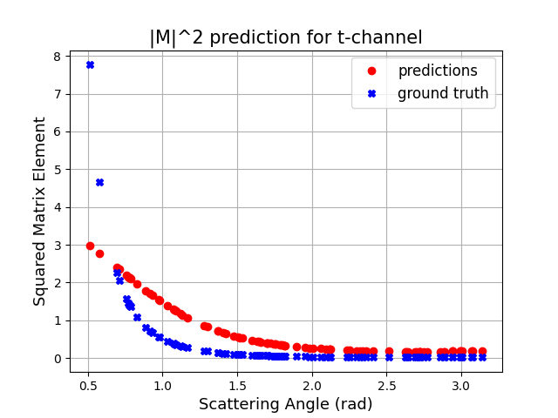

Performance for multiple Feynman diagrams II
MSE training | MSE s-validation | MSE t-validation
$$0.472±0.047$$ | $$0.121±0.067$$ | $$0.758±0.284$$
MSE s-test set: 0.104
MSE t-test set: 0.527
20/11/2023
Study of Feynman diagrams with quantum graph neural network – Lorenzo Ballerio

Slide 23







Performance for Bhabha t-channel
Bhabha t-channel:
$$e^{+}e^{−}→e^{+}e^{−}$$
high energy limit: electrons are massless
$${\overline{\left|M\right|}}^{2}=\frac{2e^{4}}{{\left(1−\cos\left(θ\right)\right)}^{2}}\left[4+{\left(1+\cos\left(θ\right)\right)}^{2}\right]$$
Divergence for $θ=0$ (cutoff for $\overline{θ}=0.5 rad$)
Architecture: 3-layers QGNN
Training MSE | Validation MSE
$$0.365±0.015$$ | $$0.369±0.080$$
MSE after test evaluation: $0.461$
20/11/2023
Study of Feynman diagrams with quantum graph neural network – Lorenzo Ballerio

Slide 24





Improvement of the model II
Performance for a 5-layers QGNN:
Performance for a 3-layer QGNN with different cutoff angle ($\overline{θ}=0.5→\overline{θ^{′}}=0.6$):
Performance for a 3-layer QGNN with denser datapoints in the asymptotical region:
Test MSE: $0.417$
Test MSE: 0.068
Test MSE: 0.947
The performance does not improve with these different methods, we can conclude that the QGNN has saturated is expressive power; the asymptotical region is basically predicted in the same way.
20/11/2023
Study of Feynman diagrams with quantum graph neural network – Lorenzo Ballerio

Slide 25
Conclusions and Future Directions

Slide 26


Conclusions and Future Directions
Quantum Graph Neural Network:
Strong performance of the QGNN for Bhabha s-channel, both in high (MSE $∼1.8×{10}^{−9}$) and low energy limit (MSE $∼1.7×{10}^{−7}$):
Slight decrease of performance in the low energy case, difficulties for $p→0$.
Fails in distinguishing different topologies:
Harnessing of a Quantum Graph Transformer with all-to-all qubit connections.
Fails in the case of ${\overline{\left|M\right|}}^{2}$ with vertical asymptote (MSE $∼0.461$)
it seems not to significantly benefit from methods that balance the divergence (e.g. change of the cutoff angle, denser sampling, deeper QGNN).
Future directions:
Exploit quantum computing properties in order to compute for free interference term between different Feynman diagrams (can not be done in ML):
There is a phase ambiguity due to the way the QGNN computes ${\overline{\left|M\right|}}^{2}$, the model is not suitable for this application.
20/11/2023
Study of Feynman diagrams with quantum graph neural network – Lorenzo Ballerio

Slide 27
Backups

Slide 28


Feature Map II
Feature Map circuit $U(G,θ,p, α)$:
$H= \frac{1}{\sqrt{2}}\left[\begin{matrix}1 & 1 \\ 1 & −1\end{matrix}\right]$ Hadamard gate
$R_{ZZ}\left(φ\right)=\exp\left(−i\frac{φ}{2}Z⊗Z\right)$ Ising ZZ coupling gate
$R_{X}(θ)=\exp\left(−i\frac{θ}{2}X\right)$ single qubit rotation along X-axis
$R_{2}\left(γ,ρ\right)=\frac{1}{\sqrt{2}} \left[\begin{matrix}1 & e^{−iρ} \\ e^{iγ} & e^{i(ρ+γ)}\end{matrix}\right]$ for massive fermions
$R_{1}\left(τ\right)=e^{iτ}R_{Z}\left(τ\right)= \left[\begin{matrix}1 & 0 \\ 0 & e^{iτ}\end{matrix}\right]$for massles fermions
20/11/2023
Study of Feynman diagrams with quantum graph neural network – Lorenzo Ballerio

Slide 29







Improvement of the model I
How to deal with the vertical asymptote of ${{\overline{\left|M\right|}}_{t}}^{2}$?
Try to enlarge the circuit: 5-layers QGNN
Put a regulator in the denominator:
$\frac{1}{{\left(1−\cos\left(θ\right)\right)}^{2}}→\frac{1}{{\left(1−\cos\left(θ\right)\right)}^{2}+ε^{2}}$ with $ε→0$
Take more points on the ansatz
(similar approach as adaptive quadrature)
Change the cutoff angle $\overline{θ}→\overline{θ}′$
Training MSE | Validation MSE
$$0.322±0.015$$ | $$0.321±0.075$$
MSE during training | MSE during validation
$$0.811±0.038$$ | $$0.826±0.155$$
MSE after test evaluation: $0.417$
MSE after test evaluation: 0.947
Training MSE | Validation MSE
$$\left(0.558±0.020\right)×10^{−1}$$ | $$\left(0.564±0.130\right)×{10}^{−1}$$
Even with relatively small $ε$ the shape of ${\overline{\left|M\right|}}^{2}$ changes drastically
MSE after test evaluation: 0.068
20/11/2023
Study of Feynman diagrams with quantum graph neural network – Lorenzo Ballerio

Slide 30





Performance for single Feynman diagram
Architecture: 3-layers QGNN:
Architecture: 5-layers QGNN:
Bhabha t-channel:
$$e^{+}e^{−}→e^{+}e^{−}$$
low energy limit: electrons are massive
$${\overline{\left|M\right|}}^{2}=\frac{2e^{4}}{p^{4}{\left(1−\cos\left(θ\right)\right)}^{2}}\left[{\left(p^{2}\left(1+\cos\left(θ\right)\right)+2m^{2}\right)}^{2}+2\left(2p^{4}−m^{4}\right)\right]$$
Divergences:
for $θ=0$ (cutoff for $\overline{θ}=0.5 rad$)
for $p=0 p∈[1.0,5.0]$ MeV
MSE during training | MSE during validation
$$0.783±0.037$$ | $$0.771±0.140$$
MSE during training | MSE during validation
$$0.681±0.036$$ | $$0.654±0.113$$
MSE after test evaluation:
3-layers= 1.167
5-layers = 1.016
20/11/2023
Study of Feynman diagrams with quantum graph neural network – Lorenzo Ballerio

Slide 31






$μ$-pair Production
Bhabha s-channel low-energy limit:
$${\overline{\left|M\right|}}^{2}=e^{4}\left[1+p^{2}\cos^{2}\left(θ\right)\left(\frac{1}{p^{2}+m_{e}^{2}}−\frac{M_{μ}^{2}}{{\left(p^{2}+m_{e}^{2}\right)}^{2}}\right)+ \frac{m_{e}^{2}+M_{μ}^{2}}{4\left(p^{2}+m_{e}^{2}\right)}\right]$$
This process has an energy threshold: $E_{tot}≥2M_{μ}⇒p≥\sqrt{M_{μ}^{2}−m_{e}^{2}}$
$p∈[120 , 250]$ MeV, $θ∈\left[0,π\right]$
Training MSE | Validation MSE
$$\left(5.745±1.173\right)×{10}^{−7}$$ | $$\left(4.871±1.654\right)×{10}^{−7}$$
MSE after test evaluation: $4.331×{10}^{−7}$
20/11/2023
Study of Feynman diagrams with quantum graph neural network – Lorenzo Ballerio

Slide 32
The Impossibility for an Interference Protocol

Slide 33



Phase Ambiguity
Exploit Quantum Machine Learning properties to predict the interference term between two or more Feynman diagrams.
Interference: $2Re\left(M_{1}^{∗}M_{2}\right)≡M_{1}^{∗}M_{2}+M_{1}M_{2}^{∗} M_{1},M_{2}∈ℂ$
Take 2 pre-trained QGNNs for two Feynman diagrams $[G_{1},G_{2},θ,p]$:
$${\overline{\left|M_{1}\right|}}^{2}\left(G_{1},θ,p\right)≡〈O_{1}〉={\left|α(G_{1},θ,p)\right|}^{2}a^{2}+{\left|β(G_{1},θ,p)\right|}^{2}b^{2}$$
${\overline{\left|M_{2}\right|}}^{2}\left(G_{2},θ,p\right)≡〈O_{2}〉={\left|γ(G_{2},θ,p)\right|}^{2}c^{2}+{\left.​|δ(G_{2},θ,p)\right|}^{2}d^{2}$
$$\left\{\begin{aligned}Re\left(M_{1}\right)=\sqrt{{\left|α\right|}^{2}a^{2}+{\left|β\right|}^{2}b^{2}}\cos\left(φ\right)≡\overline{\left|M_{1}\right|}cos⁡(φ) \\ Im\left(M_{1}\right)=\sqrt{{\left|α\right|}^{2}a^{2}+{\left|β\right|}^{2}b^{2}}\sin\left(φ\right)≡\overline{\left|M_{1}\right|}sin⁡(φ)\end{aligned}\right.$$
$$\left\{\begin{aligned}Re\left(M_{2}\right)=\sqrt{{\left|γ\right|}^{2}c^{2}+{\left|δ\right|}^{2}d^{2}}\cos\left(ρ\right)≡\overline{\left|M_{2}\right|}cos⁡(ρ) \\ Im\left(M_{2}\right)=\sqrt{{\left|γ\right|}^{2}c^{2}+{\left|δ\right|}^{2}d^{2}}\sin\left(ρ\right)≡\overline{\left|M_{2}\right|}sin⁡(ρ)\end{aligned}\right.$$
$$2Re\left(M_{1}M_{2}^{∗}\right)=2\left(Re\left(M_{1}\right)Re\left(M_{2}\right)+Im\left(M_{1})Im(M_{2}\right)\right)=\overline{\left|M_{1}\right|}\overline{\left|M_{2}\right|}cos⁡(φ−ρ)$$
It’s necessary to tune for each couple of Feynman diagrams $[G_{1},G_{2},θ,p]$ the angle $τ=φ−ρ.$
20/11/2023
Study of Feynman diagrams with quantum graph neural network – Lorenzo Ballerio

